Slide 2
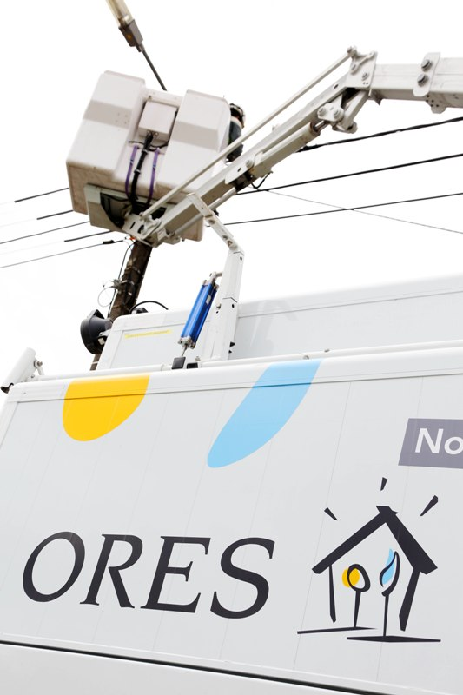
Investor Presentation
2022

Slide 3
Disclaimer
This presentation contains confidential information and none of its content (or any part thereof) may be modified, reproduced or distributed to any other person in any form or by any means, directly or indirectly, without the prior written consent of ORES cs.
The term ORES refers either to ORES cs ; to ORES cs and to ORES Assets, a Walloon Distribution System Operator (DSO) ; to ORES cs, ORES Assets and Comnexio (ORES Assets’ subsidiary) ; or ORES cs, ORES Assets, Comnexio and Atrias (company in which ORES Assets holds shares).
Forward-looking statements in this presentation do not guarantee future performance. Actual results may differ materially from such forward-looking statements as a result of a number of uncertainties or risks, many of which are out of control of ORES, ORES Assets, its subsidiaries, their shareholders and company in which ORES Assets holds shares. Forward-looking statements speak only as at the date of this document.
The information contained in this presentation is subject to amendment, revision and updating. It is in no way an investment advice or a recommendation to subscribe or purchase any securities.

Slide 4
Table of contents
Company and business overview
Regulatory framework
Financials
Strategic plan 2021-2023

Slide 5
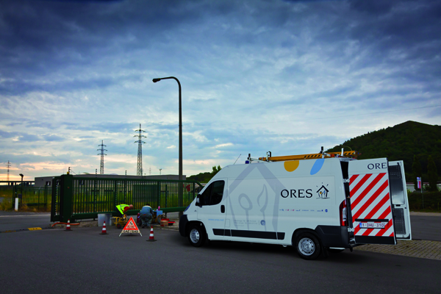
1. Company and business overview

Slide 6
Table of contents
Shareholder structure
ORES in a nutshell
The role of a Distribution System Operator (DSO)
Key considerations
Some highlights 2021
Recent events – some 2022 highlights
Regulated Asset Base
A network of quality

Slide 7



Shareholder structure (31/12/2021)
Municipalities
(200 – 3.17%)
Intermunicipalities
(8 – 96.83%)
ORES Assets - Distribution System Operator (DSO)
Legal monopoly for the area covered by its network (20 years maximum in the Walloon Region, renewal for 2023, procedure being finalised)
Legal status : company of public law
Owner of the assets
No employees
Activities carried out are almost entirely regulated
Intermunicipalities have lifetime statutory limited (2045), some municipalities have to confirm their participation for 2025 (157 have confirmed)
Intermunicipalities
(7)
ORES Assets
0.28 %
99.72 %
ORES
ORES - Operational Management
No assets
Main employer of the Group
All operations at cost price
7 %
93 %
Comnexio
17 %
Atrias
Contact Center
Support customer service
All operations at cost price
Federal Clearing House
Application that supports the market model and the market processes
All operations at cost price

Slide 8
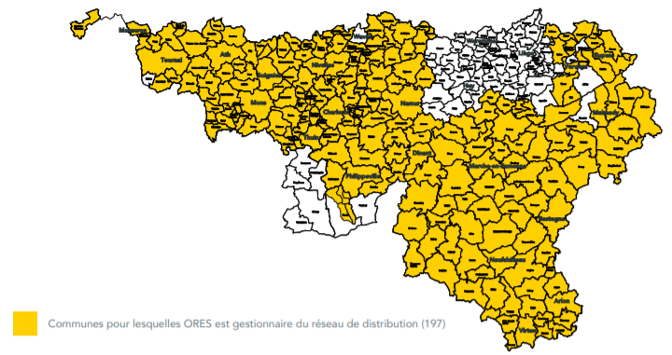
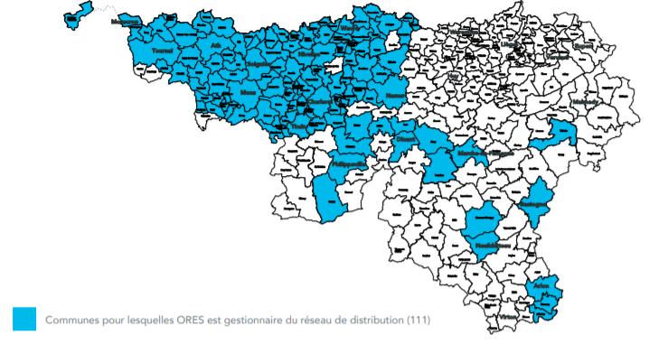
ORES in a nutshell
2021 figures | ELECTRICITY | NATURAL GAS
Network length (km) | 52,058 | 10,111
Energy distribution (MWh) | 12,032,198 | 15,226,916
Access points (actives ones) | 1,392,186 | 522,365
RAB (€) | 2,612,752,041.87 | 1,302,945,384.98
Geographical presence
Street light installations | 463,132

Slide 9
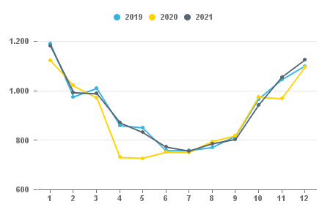
ORES in a nutshell
Evolution of electricity quantities - Infeed

Slide 10
The role of a Distribution System Operator (DSO)
Responsible for the management, maintenance, adaptation and development of the electricity and natural gas distribution grids, which also includes :
Organisation of objective and non-discriminatory access to the distribution network
Ensure security, reliability and efficiency of the electricity and natural gas distribution grids
Take care of the day-to-day operation of the electricity and natural gas distribution grids
Take care of the day-to-day opex and capex of the municipalities’ public lighting grid
Implement the necessary conditions for the harmonious functioning of the market on its networks by managing all market’s processes data’s :
Establish new connections to the electricity and natural gas distribution grids (install meters) ; adapt connectivity and upgrade meters
Manage register
Public services obligations :
Social obligations :
Supply energy to protected customers at the request of customers
Install prepaid meters
For public lightning : Operate and maintain public lighting for municipalities and promote energy efficiency (E-lumin program : replacement of 463.000 public lightings for 2030)

Slide 11
Key considerations
Strategic importance for the Walloon Region
ORES/ORES Assets carry out numerous public services obligations
ORES provides the daily distribution of energy to more than 1,4 million households and small and medium-sized enterprise in the Walloon Region
Legal monopolistic business
ORES Assets has a legally based regional monopoly for electricity and gas distribution to households and small and medium-sized enterprise
Low business risk
ORES/ORES Assets is not involved in activities that are subject to competition related to production, trading and supply
ORES/ORES Assets cover more than 75% of the municipalities in the Walloon Region
Regulated business and predictable cash flow generation
Healthy balance sheet structure
Activities conducted by ORES/ORES Assets are almost entirely regulated
Healthy balance sheet structure and financial leverage (gearing normative : equity ratio : 47,5%)
Efficient operating structure
ORES acts as the sole entity for ORES Assets in the Walloon Region
Tariffs 2019-2023 approved by the CWaPE (regional regulator)
Predictable revenue of DSO based on a revenue cap model, determined in a legal and regulatory framework (regional framework) ; tariff mechanism with a-5 years regulatory period
ORES/ORES Assets operate essential utility service : electricity and gas distribution and public lighting
“Mirrored” Boards of directors, Audit committees and (appointment) and remuneration committees (ORES and ORES Assets)
ORES Assets owns 100% of the distribution network infrastructure

Slide 12
Some highlights 2021
2,306 FTE on 31 December 2021 (2,293 FTE in 2020 – 2,328 in 2019) (active staff)
CWaPE approved :
  electricity and gas regulatory balances 2017, 2018, 2019 and 2020
  allocation to tariffs of electricity and gas regulatory balances 2017, 2018 and 2019
  revision of the additional envelope dedicated to smart meters
ORES Assets Board of Directors approved tariff equalisation from 1 January 2024
Form this date onwards, a single tariff per type of customer will be applied by ORES Assets instead of a tariff per type of customer per territory corresponding to former Walloon mixed DSOs existing in 2012, before the merge to create ORES Assets
End of 2021 : exchange with the CWaPE on the timetable for the 2024-2028 methodology

Slide 13
Some highlights 2021
3 energy suppliers lost their licenses, either at their own request or due to non-compliance with network access conditions (no major financial impact for ORES)
February : start of the renewal procedure for DSO mandates
June and July : several climatic events had strong impact on the electricity distribution network, including dramatic floods of 14-16 July and a tornado (no major financial impact for ORES)
October : repayment of the bond issued in 2012 that reached maturity
November : go live of the Atrias platform
Extension of the protection status for households affected by the economic crises and payment of premiums by DSOs for regional and federal authorities

Slide 14
Some highlights 2021
Continuation of projects related to the energy transition
June : implementation and generalization of “O-One” (forecast and management of congestion risk on the network)
June and Augustus : two additional injections of green gas into the Walloon distribution network
October : placement of the 30,000th smart meter
2021-2023 strategic plan - update 2022

Slide 15
Recent events – some 2022 highlights
Renewal of DSO designation :
Procedure being finalized by mid 2022
Procedure involving :
A proposal from the municipalities
An opinion from the regulator (favorable opinion for 100% municipalities for gaz – for 96.4% in electricity (1 municipality decided to change DSO and others didn’t decide, decide properly or decide in time))
A designation by the Walloon Government (to be finalized)
Tariff methodology 2024-2028 :
Launch of the public consultation and discussions with DSO on 31 May
Procedure being finalized by November

Slide 16
Regulated Asset Base
 | E 2019 | E 2020 | E 2021 | G 2019 | G 2020 | G 2021
Tangible | 98.0 % | 98.1 % | 98.2 % | 98.6 % | 98.8 % | 99.0 %
Intangible | 2.0 % | 1.9 % | 1.8 % | 1.4 % | 1.2 % | 1.0 %
RAB almost exclusively
consists of tangible assets

Slide 17
A network of quality
Electricity – Indicators of reliability of the distribution network (MV)
Accidental cause
Planned

Slide 18
A network of quality
Gas – Indicators of reliability of the distribution network

Slide 19
A network of quality
Results of satisfaction survey amongst clients
2021 : 81,4% (81,9% in 2020)
Complaints and compensation
The 2021 increase in quality KPI is due, among other things, to the July floods and ORES' proactive policy to encourage customers to complain

Slide 20
Table of contents
Company and business overview
Regulatory framework
Financials
Strategic plan 2021-2023

Slide 21

2. Regulatory framework

Slide 22

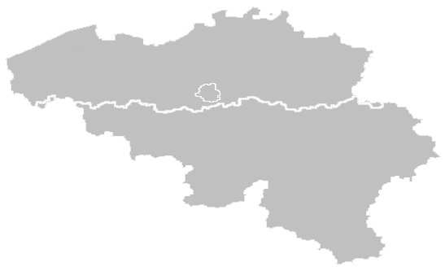



Regulatory framework
Introduction – Energy regulation and its evolution
Energy distribution is a regional competence, including technical regulations, local distribution of natural gas and electricity, fulfilment of public service obligations, approval of investment programmes and tariff competences
In the Walloon Region, the regulator is the CWaPE (Commission Wallonne pour l’Energie)
The CWaPE is an independent body, established by the Electricity and Gas Decrees as an autonomous body with legal personality, in accordance with EU directives
Walloon Region
Until 2014
Tariff methodology and tariff approval by the Creg on a “Cost plus” basis
2015 to 2018
Tariff methodology and tariff approval by the CWaPE on a “Cost plus” basis
2019-2023
Tariff methodology and tariff approval by the CWaPE on a “Revenue cap” basis
2024-2028
Tariff methodology to be determined
Creg competency
CWaPE competency

Slide 23
Tariff methodology 2019-2023
Introduction
Aim of the CWaPE is to introduce more incentive-based tariff regulations :
  Control of costs in the traditional areas of management and investments
  Incentive to participate in or undertake research and development projects, as well as the rollout of innovative solutions (specific projects)
Adopted, after consultation with the DSOs and market players, on 17/07/2017 (two amendments on 11/10/2018 and one on 02/12/2021)
Regulatory period of 5 years
Two-step approval of tariffs :
    Approval of total authorised revenues : based on a 5-year business plan approved after a detailed examination of costs, particularly with regard to ensuring they are reasonably justified
    Transposition of total authorised revenues in the tariffs
General principles – “Revenue cap”
The authorised income is set ex-ante for each year of the regulatory period 2019-2023
The total income of a DSO is made up of the following elements : (i) net controllable expenses, (ii) non-controllable expenses and income, (iii) net expenses related to specific projects, and (iv) fair profit margin. To which is added the share of regulatory balances
All net charges not identified as non-controllable are considered controllable
In addition, a quality factor (“Q” factor) will be taken into consideration from 2024 onwards

Slide 24
Tariff methodology 2019-2023 – Specific principles
Net controllable expenses
    Net controllable expenses other than those related to fixed assets : principle of a “revenue cap” (capped, indexed and subject to an efficiency factor). These expenses are fixed for 2019 and will then be adapted based on inflation, minus an efficiency “X” factor ; inflation has been fixed at 1.575% and the “X” factor at 1.5%
    Net controllable expenses related to fixed assets : principle of a “revenue cap” (capped and indexed, but not subject to the “X” factor). Depreciation and amortisation charges are fixed for 2019 and will then change based on inflation
Non-controllable net expenses : these expenses are not capped and are not subject to the “X” factor. The differences between non-controllable expenses actually incurred and budgeted constitute regulatory balances that are passed on in the tariffs
Net expenses related to specific projects : the DSOs can obtain additional budgets for the rollout of smart meters and the promotion of natural gas networks
Fair profit margin : RAB * WACC ; where the RAB changes each year based on investments, depreciations, decommissioning, etc. and where the WACC is set at 4.053% for the whole regulatory period. Debt costs are included in the calculation of the WACC and no longer constitutes “embedded costs”
WACC is after tax – taxes are passed on in full in the tariffs

Slide 25
Tariff methodology 2019-2023 - Regulatory balances
Ex-ante audit : total authorised revenue and tariffs (as stated previously)
Ex-post audit :
  Specific controls of initiatives or following comments or questions from the final customer
  Control after the closure of a financial period, based on the annual report introduced by the DSO on the differences between budget and actual for :
    Income from periodic tariffs (difference between the actual volumes of gas and electricity distributed and the volumes budgeted) : passed on in the tariffs
    Non-controllable operating income and expenses : passed on in the tariffs
    Controllable net operating expenses : incurred by associates (self-financing capacity) (exception of the volume effect of certain OSP)
    Fair profit margin : passed on in the tariffs. The difference may be due to the evolution of the RAB
    Net expenses related to specific projects : by type, spread across the tariffs or supported by associates
  The tariff methodology provides for the integration of these balances in the tariffs in N+2
  The regulatory balances for the period 2008-2014 are recovered progressively as deposits (recovery of deposits provided for in the tariff methodologies, but no decision from the CWaPE yet regarding the height of and/or allocation of balances)
  The regulatory balances for the period 2015-2020 have been approved and are recovered progressively

Slide 26
Future developments : methodology 2024-2028
Under discussion
Preparatory work started in 2019 :
  DSO performance indicators (identification and definition of performance indicators through guidelines)
  Study on the macro-economic evolution of electricity and gas distribution sectors in Wallonia (analysis and quantification of the impact of the evolutions which will have an influence on the job/activity/missions of the DSOs in order to determine for each energy vector a cost evolution factor for the Walloon DSOs)
  Study on the measurement of DSO efficiency (proposal for an appropriate method of measuring the individual efficiency of Walloon DSOs to replace the efficiency factor common to all DSOs by an individual factor for the period 2024-2028)
  Study on the evolution of low voltage electricity distribution tariffs (determination of the priority objectives of the future tariff methodology and identification of the different tariff structures - reflection on the applicable time slots)

Slide 27
Table of contents
Company and business overview
Regulatory framework
Financials
Strategic plan 2021-2023

Slide 28

3. Financials

Slide 29
Summary financials 2021 (actuals)
Economic Group ORES/DSO (IFRS)
In M€
Income statement | 2020 | 2021 | Balance sheet | 2020 | 2021
Total operating income (Turnover and other operating income including rate rgulated balances) | 1,249 | 1,302 | Total Current Assets incl. CASH | 389 73 | 616 216
EBITDA | 471 | 476 | Total Non Current Assets | 4,264 | 4,318
EBIT | 259 | 291 | Total Assets (excluding rate regulated balances) | 4,653 | 4,934
Financial Result | -35 | -19 | Total Assets | 4,768 | 5,022
Net Profit | 170 | 194 | Financial debt | 2,255 | 2,293
Global Income Profit Result | 197 | 177 | Total Shareholders’ Equity | 1,860 | 1,967
 |  |  | Total Liabilities & Equity (excluding rate regulated balances) | 4,737 | 5,017
 |  |  | Total Liabilities & Equity | 4,768 | 5,022

Slide 30
A limited commercial risk…
The revenues linked to the use of the ORES Assets networks (regulated tariffs) represent 96.1% of the BGAAP consolidated turnover of ORES Assets.
Detail of the consolidated turnover :
Suppliers (grid fee) : 1,218 M€
  Transport grid fee : 419 M€
  Electricity distribution grid fee : 581 M€
  Gas distribution grid fee : 218 M€
Social customers (for consumption of energy) : 26 M€
Work for third party : 24 M€
Periodic tariffs, regulated by DSO or by sector, submitted to prior approval of the CWaPE :
  DSO invoices costs to energy suppliers
  Suppliers add these costs to the energy bills of final customers
  This means that the energy bill sent by suppliers to their customers not only includes the energy consumed, but also the costs that have been charged by the network operators for the transmission and distribution of the energy, or even taxes and contributions to the development of green energy
  The costs of the electricity transmission system operator networks are charged to the suppliers through the DSO
  ORES Assets has the right to request a financial guarantee from the suppliers
Illustrative example for electricity

Slide 31
A limited commercial risk…
GRIDFEE | ELECTRICITY
 | 2021 | 2020 | Difference
Trans MV | 48,294,138 | 44,049,027 | 4,245,111
MV | 179,166,805 | 174,989,717 | 4,177,088
Trans LV | 35,986,333 | 35,845,025 | 141,308
LV | 719,348,878 | 642,534,957 | 76,813,921
Total | 982,796,154 | 897,418,726 | 85,377,428
GRIDFEE | GAS
 | 2021 | 2020 | Difference
Group 1 (< 1,000,000 kWh) | 205,833,311 | 188,370,469 | 17,462,842
Group 2 (between 1,000,000 and 10,000,000 kWh) | 7,895,188 | 6,401,850 | 1,493,338
Group 3 (> 10,000,000 kWh) | 2,136,168 | 2,194,304 | -58,137
Injection | 87,971 | 0 | 87,971
CNG | 412,625 | 330,835 | 81,790
Total | 216,365,263 | 197,297,459 | 19,067,804

Slide 32
Indicative funding needs (M€)
Electricity and gas
 | TOTAL | Refinancing | Others
Financing needs 2022 | 150
Financing needs 2023 | 248 | 173 | 75
Financing needs 2024 | 224 | 152 | 72
Financing needs 2025 | 263 | 164 | 99

Slide 33
Debt management (1/2)
Evolution of the gross debt

Slide 34
Debt management (2/2)
Debt maturity 31.12.2021
Debt average duration : 11 years and 8 months

Slide 35
Financial indebtedness with mainly fixed interest rates

Slide 36
Actual funding sources
CP Program
  Total size program : 550 M€
  Use at 31/12/2021 : /
Undrawn Credit
Line
  Total size facilities : 50 M€
  Use at 31/12/2021 : /

Slide 37
Financial policies and strategy
ORES Assets guarantees the debt
Interest rate swap and cap agreements used for hedging purposes only (solely derivatives non-speculative)
Average maturity at least equal to 8 years
Floating rate debt for a maximum of 50% of the total debt
As of 2019 : cost of debt in the WACC computation set at 2.74%
Non-anticipatory funding of financial debts maturing in the year (unless there is an opportunity or economic context)
Currency : €
Funding management
Intra-group cash pool
Credit line (50 M€) and CP program (maximum 550 M€)
Maintaining a level of cash equivalent to 2 months of turnover
Compliance with the outstanding amount of cash authorized by the banks
Controlling the cost of holding excess cash
Currency : €
Cash management

Slide 38
Principes de gestion financière…
Capital structure
Equity ratio / total consolidated balance sheet (BGAAP) : 40.78%
Optimal minimum gearing : 40% equity ratio / equity + financial debt (45.5%)
The main revenue (more than 90%) of ORES is the gridfee which is invoiced to the energy suppliers. The payment term is 20 days.
Payment for work done for clients (new connections,…) are billed and paid in advance. The projects are only realized after payment by the customer (except for the associated municipalities which can pay after the works but for which there can be withholdings on dividends). These interventions are deducted from the amount of the investments.
Receivables
RAB valuation
The Regulated Asset Base (RAB) includes the net economic value to rebuild the fixed assets
The RAB evolves with the new investments, amortization and divestments
Investments influenced by the legal obligations of ORES (distribution network, PSO,…)
Investments are reviewed by the regulator
Key factors to determining the investments are : maintenance, security and resilience of the network, security of energy supply and the transformation in the context of energy transition
Access to the network for new customers and the connection of renewable energy production sites are also part of the obligations of ORES
Investment
Budget
ORES has a yearly budgeting exercise and a long-term plan (2019-2023 / preparation of the 2024-2028)
Monthly budget report high level
Weekly meeting financial controlling team
Dividends
Limited dividend payout ratio (70% of the fair profit margin since 2019)

Slide 39
Table of contents
Company and business overview
Regulatory framework
Financials
Strategic plan 2021-2023

Slide 40
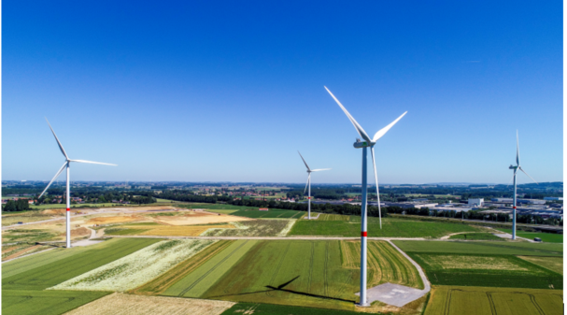
4. Strategic plan 2021-2023
Our energy and expertise working to achieve an energy transition for all and at a local basis

Slide 41
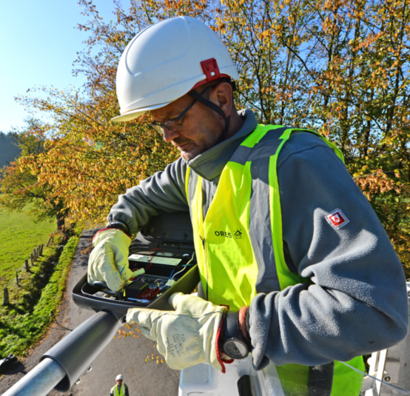
The very core of our action
Facilitating energy,
making life easier
There’re some continuity with our plan strategic 2021-2023
In a changing and complex world of energy, ORES wants to be a cause of simplification
“Facilitating energy, making life easier” for residential, professional and business customers so that they can focus fully on their works while benefiting from efficient responses and services that meet their expectations

Slide 42
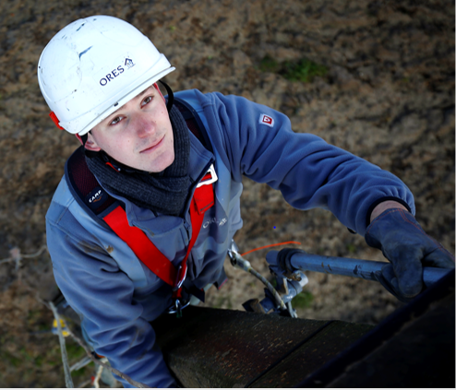
Our vision
Our energy and expertise working to achieve an energy transition for all and at a local basis

Slide 43



3 developments
MAKE AN ACTIVE CONTRIBUTION TO ENERGY TRANSITION FOR ALL, ENSURING THAT ALL WALLOONS ARE INCLUDED
BE OPEN TO CHANGE AND BE AVAILABLE TO CONTRIBUTE TO WALLONIA'S PROJECT
REAFFIRM OUR LOCAL CHARACTER
Notes:
Continuité, mais aussi évolution
3 éléments :
Une choix fort qu’ORES pose : être le partenaire de la transition énergétique en Wallonie, une transition énergétique qui n’oublie personne, une transition énergétique pour tous.
Nous devons être ouverts aux changements, à tout moment proposer une valeur ajoutée, chaque fois que nous pensons disposer de moyens, de compétences, de connaissances pour être au service de la transition énergétique en Wallonie. Lorsque nous pouvons être un facteur d’accélération, nous sommes disponibles pour prendre nos responsabilités et contribuer au projet de la Wallonie.
ORES veut réaffirmer son caractère local : être le partenaire des projets de circuits courts de l’énergie, être le partenaire de sociétés, d’entreprises et d’organismes qui s’occupent d’énergie avec nous en Wallonie, et en premier lieu être le partenaire des Villes et Communes pour et avec lesquelles nous travaillons quotidiennement.

Slide 44
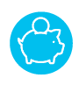
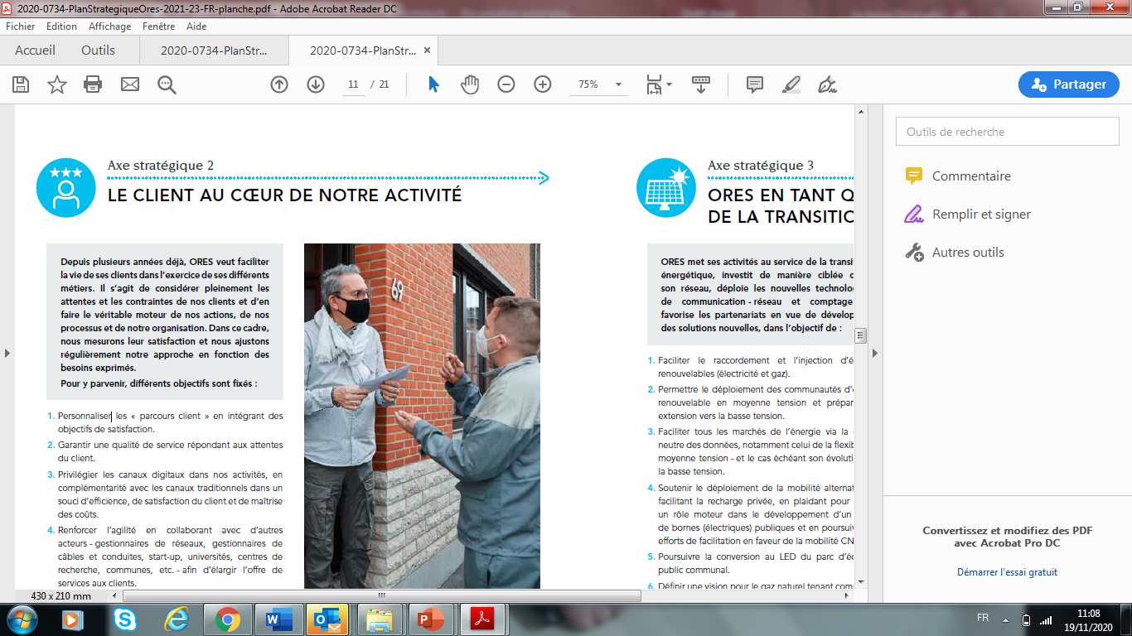
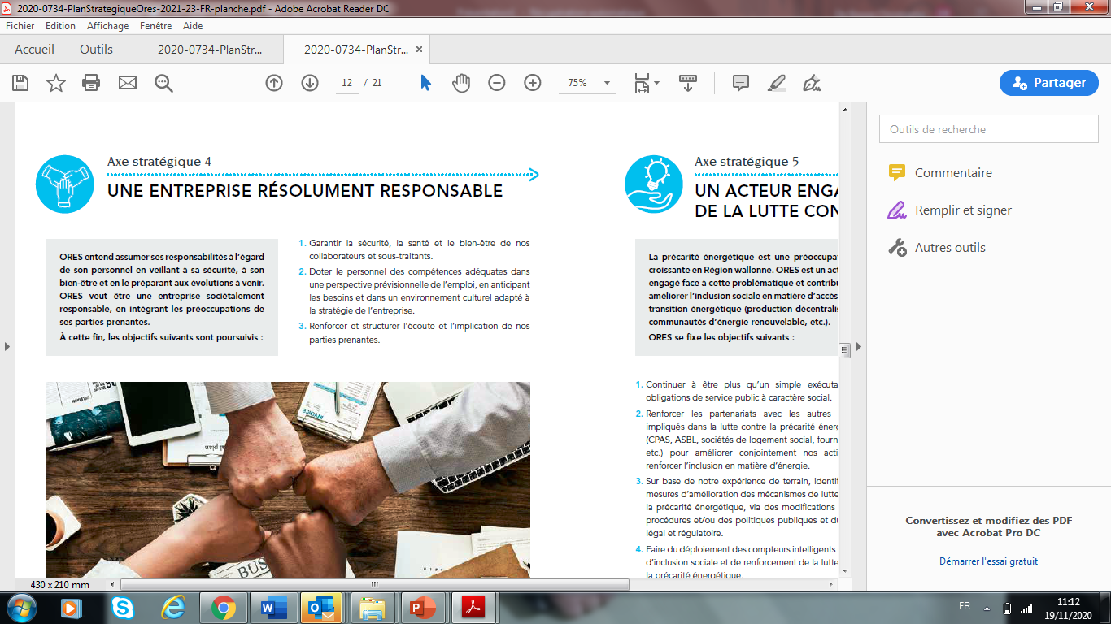
A practical 5-points strategy
Strategic point 1
COMPETIVE TARIFFS FOR DIFFERENT ORES CUSTOMERS
Strategic point 2
THE CUSTOMER AT THE HEART OF OUR BUSINESS
Strategic point 3
ORES AS AN ACCELLERATOR OF ENERGY TRANSITION
Strategic point 4
A STRONGLY RESPONSIBLE COMPANY
Strategic point 5
A COMPANY COMMITTED TO SOCIAL INCLUSION AND THE FIGHT
AGAINST ENERGY POVERTY

Slide 45



Transversal mobilizing levers for the company
CORPORATE CULTURE
TRANSFORMATION PLAN
POLICY ON SUSTAINABLE DEVELOPMENT

Slide 46

To look beyond 2023
ORES’s strategy does not stop in the short term, in 2023. We wanted to look further ahead – to 2030 – to see how our sector, how electricity and gas distribution businesses are likely to evolve over a decade.

Slide 47
Transformation plan
Implementing strategy and bringing vision to life successfully are based on the introduction of a transformation plan
It sequenced the implementation of projects in order to optimize investments, to ensure the effectiveness of each initiative and to allow proper management of the risks associated with the execution of these projects
It groups the projects into 8 programmes or clusters :
Switch programme
E-lumin programme
Smart grid programme
Atrias programme
NEO programme
Business line cluster
Customer cluster
Data programme

Slide 48
Transformation plan
Focus on Switch programme (smart meters)
Project :
to ensure the optimum rollout of smart meters so that positive feedback can be maximized for all customers and for society in general.
that will make a significant contribution to the wish expressed, more and more often, especially by public authorities, of enabling consumers to be in control of their energy and to become players in the energy market, via flexibility in particular.
be able to install a type of meter that allows, among other things, to measure consumption and production more accurately, to read them remotely,…
have the technologies to meet the changing expectations of customers, the needs of market players,...
get ready for the deployment of these meters (processes modernization, news computer tools,… => make the services available)
The Walloon Parliament determined a deployment timetable :
  on a compulsory basis and with priority per segment (customer declared in default of payment, meter replacement, new meter, on demand) - possibility for the customer to refuse in case of electro-sensitivity
  start in 2023 - by 2030 : equipment of 80% of high-electricity consumption, self producer (in excess of 5 kVA) and customer acting as a recharging point open to the public
+ in 2020 : decision to grant a premium to cover the costs of placing smart meters with residential customers (until 31/12/2023)
from a generalized deployment initially thought by ORES to a segmented deployment with priority
The technical solution has to be adapted to the change of deployment (in electricity : Sagecom with wireless communication NB-IOT)
Revision of the business case to take account of these changes (approved by the CWaPE in 2021)

Slide 49
Transformation plan
Atrias programme
Aims to improve communication between all the parties on the energy market in Belgium via a new definition of market processes and the use of a shared federal IT platform
Essential base for managing the market of tomorrow, developing new products and services and encouraging the rollout of renewable energy (dynamic tariffs, flexibility, etc.)
On 1st January 2022, the Atrias and Switch programmes have been grouped as a part of a more extensive programme, designed to cover all market dimensions
E-lumin programme
Aims to convert all municipal public lighting to LED technology by 2030 (with positive impact on emissions CO₂)
Implementation of a new service “service Lumière” that will facilitate the management of public lighting and speed up repair and replacement work (176 councils have joined this service at the end of Augustus 2021)

Slide 50
Transformation plan
Smart grid programme
Aims to modernize IT tools, adjust the organisation and processes and increase telemetry and remote-control operations across the network
Will make it possible to increase the capacity to accommodate renewable energy – including by way of flexibility. It will also be possible to guarantee the quality of supply and will also help contribute towards greater control over investments for the networks
This programme provides a “230/400V network conversion”. The aim is to structure all the themes relating to the technical framework, to human and financial resources and in terms of communication to customers, with the aim of increasing the 400V network from 45% to 65% by the end of 2030
NEO programme
  Aims to modernize and upgrade the IT tools supporting “work processes”, the management of our assets, our investments in networks, our logistics and our finances

Slide 51
Transformation plan
Business line cluster
Supports the strategic programmes by rethinking and equipping field mobility to strive for exceptional operating efficiency
Specific worksites that will make it possible to improve day-to-day operations in the short term
Customer cluster
Aims to improve customer focus to better respond to customer expectations by making their experience with ORES an exceptional one (examples : development of the online channel, social media, and telephony, as well as the implementation of a single customer reference point)
Data programme
Aims : to mobilise ORES so that it is capable of dealing with the challenges associated with the new roles of the DNMs by positioning data as the fuel for propelling the energy markets. The programme’s projects include the implementation of a data platform, the introduction of a business integration platform, the development of a roadmap relating to the management of data and putting data governance into operation, as well as establishing a quality management body

Slide 52
Industrial plan
"ORES as an accelerator of energy transition“, one of the 5 strategic axes of ORES is very challenging :
ORES is committed to the energy transition by making targeted investments in its network, deploying new communication technologies - network and metering - and fostering partnerships to develop new solutions.
What are the concrete impacts of energy transition for ORES ?
In order to better understand the concrete consequences of a carbon-neutral Wallonia in 2050, ORES entrusted Climact, a consultant specialised in these matters, with a study to measure the technological and behavioural changes as well as their impacts on the distribution networks.
They indicate that the distribution networks are at the heart of carbon neutrality and therefore extremely stressed, in all scenarios. Some major impacts will occur in the short term, by 2030.

Slide 53
Industrial plan
The investments made in the ORES networks have maintained a good quality network, which was able to cope with the first massive wave of decentralised generation.
However, new projections for renewable generation will put pressure on the network, the electrification of the transport sector will take place by 2030 and will mainly burden the low voltage network,...
Facing these observations, ORES must now implement a targeted and ambitious investment strategy in assets to enable the networks to accommodate the new uses linked to the energy transition.
ORES has established a 15-year industrial plan (2023-2038) : 1 billion euros more in infrastructure (investments in infrastructure and modernisation of IT systems to support the energy transition)

Slide 54
Industrial plan
Improve network resilience : ability to return to normal operation after a disruption :
Line burial
Ability to mitigate incidents related to more frequent extreme weather events and to quickly return to normal operation after a disruption
Supporting the energy transition :
Increasing the capacity of networks to accommodate new uses and decentralised production (photovoltaic, biomethane, etc.)
Smartisation of networks and meters
Modernising the network (obsolete) - electricity and gas
While continuing to meet customer expectations in terms of service quality

